Slide 1
WEATHER MONITORING SYSTEM

Slide 2
INTRODUCTION
IoT-based weather monitoring systems are used for monitoring weather. They collect data from a number of sensors attached such as temperature, humidity.
The collected data is sent to cloud-based applications and storage back-ends.
The data collected in the cloud can then be analyzed and visualized by cloud-based applications.
Weather alerts can be sent to the subscribed users from such applications.

Slide 3
Components Used: ESP 32 Wifi Module, DHT 11 Sensor, LED
Software: Arduino IDE
Language Used: Embedded C
DataBase: Firebase
Graphic Visualizations: ThingSpeak
App FrameWork: Blynk App, MIT Inventor App, Streamlit WebApp

Slide 4
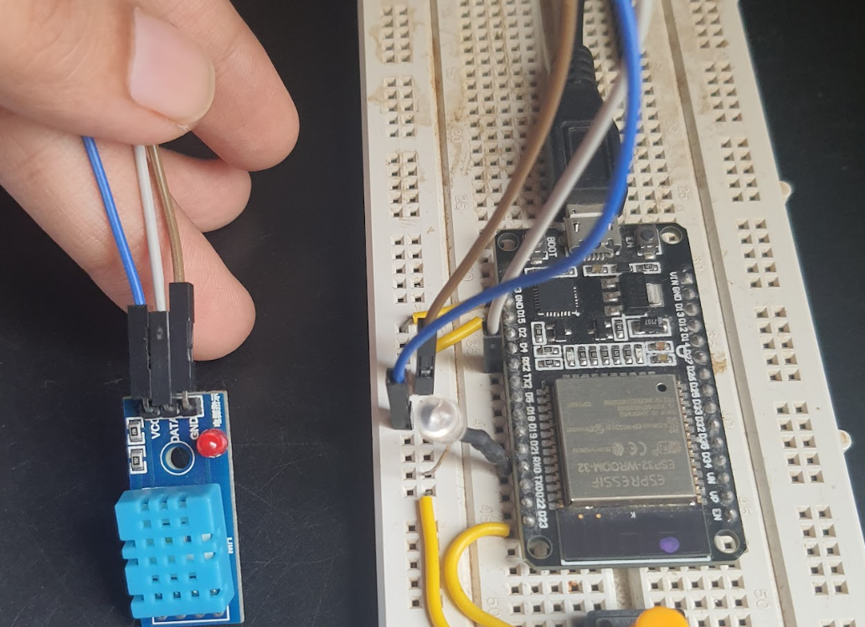
Hardware

Slide 5
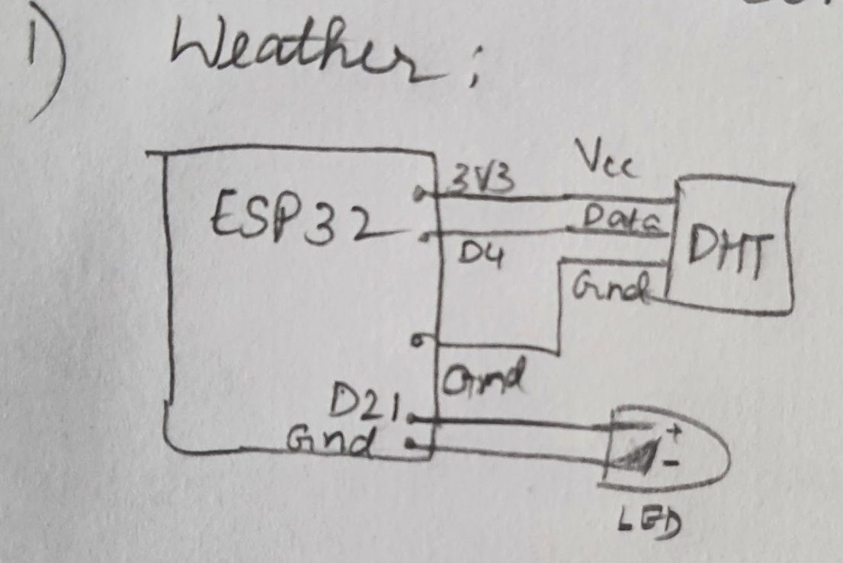
Hardware

Slide 6
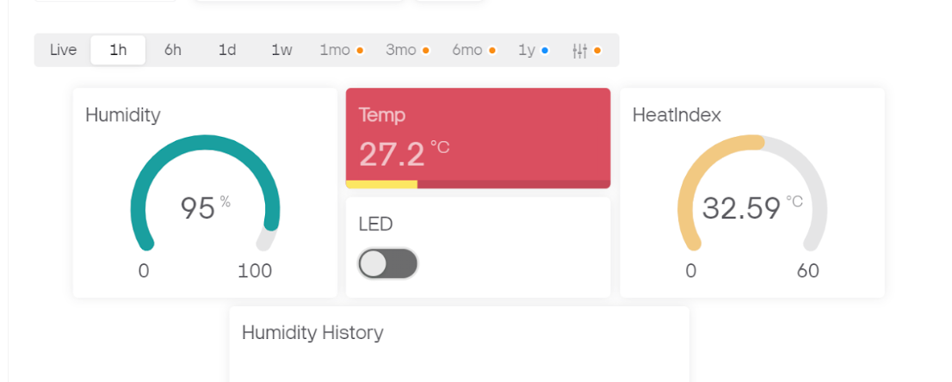
Blynk Dashboard

Slide 7
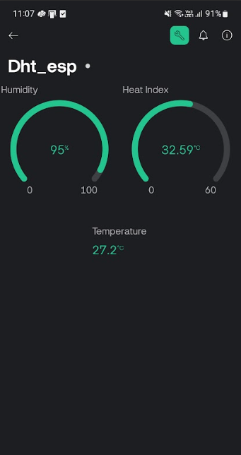
Blynk App

Slide 8
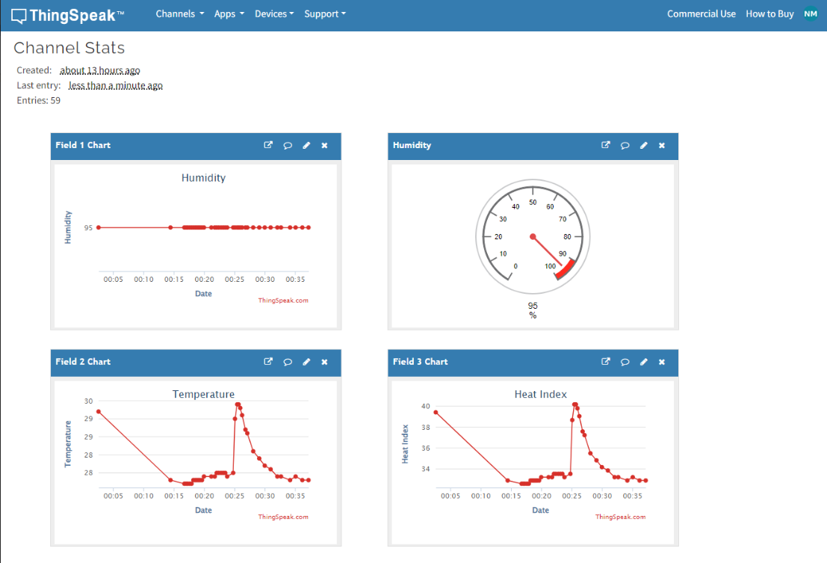
ThingSpeak

Slide 9
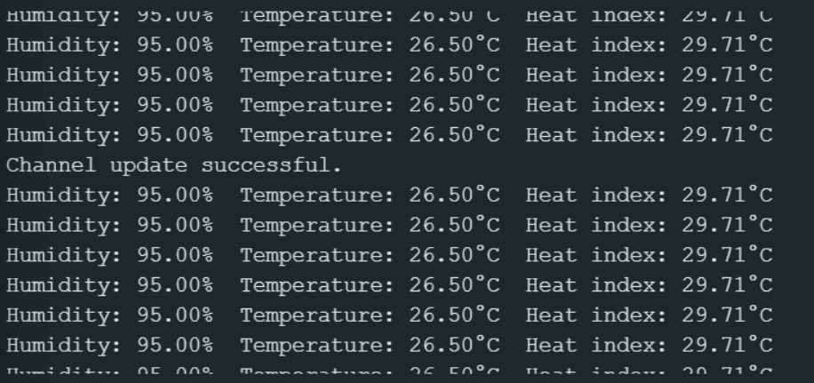
Arduino IDE

Slide 10
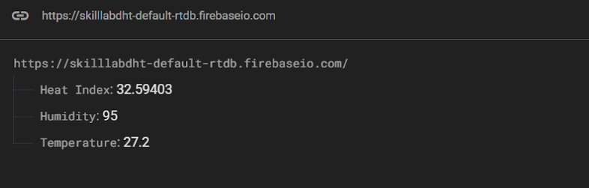
Firebase Database

Slide 11
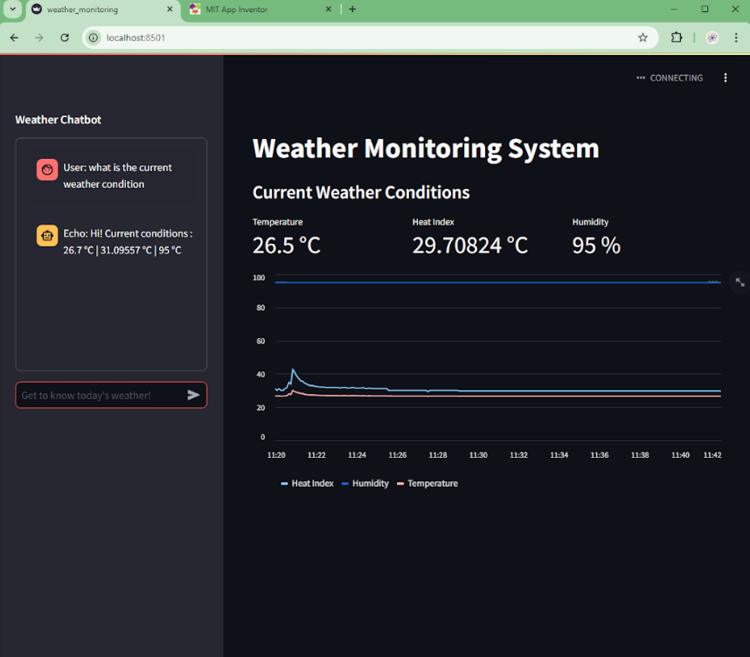
Streamlit Web App

Slide 12
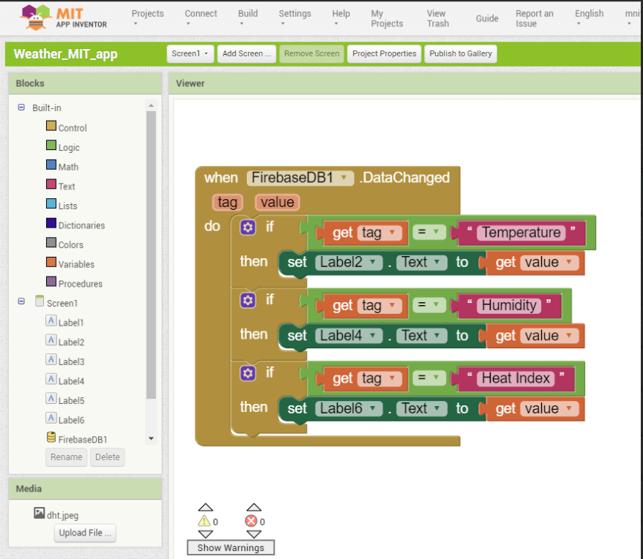
MIT INVENTOR APP

Slide 13
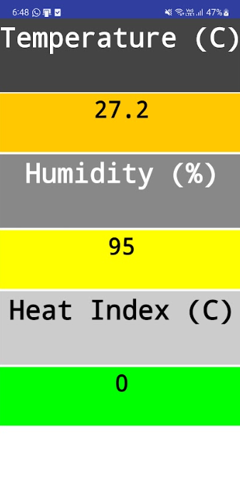
MIT INVENTOR APP

Slide 14
Weather Monitoring Chatbot

Slide 15
VIDEO LINK
https://drive.google.com/file/d/14h8tAIdBlQEnoSAP35EXMHI3ha0qiMG1/view?usp=drive_link

Slide 16
APPLICATIONS
Home Security: Monitors for unauthorized entry, sending alerts to homeowners or security services.
Banking & Financial Institutions: Protects vaults, ATMs, and secure areas, providing real-time alerts to authorities in case of breaches.
Government Buildings: Protects high-security areas, ensuring only authorized personnel access sensitive locations.
Data Centers: Safeguards critical infrastructure by detecting intrusions in sensitive zones like server rooms.

Slide 17
THANK YOU

